Slide 1
INTRODUCTION TO SQL

Slide 2
Intro
SQL is a standard language for storing, manipulating and retrieving data in databases.
RDBMS
RDBMS stands for Relational Database Management System.
RDBMS is the basis for SQL, and for all modern database systems such as MS SQL Server, IBM DB2, Oracle, MySQL, and Microsoft Access.
The data in RDBMS is stored in database objects called tables. A table is a collection of related data entries and it consists of columns and rows.

Slide 3
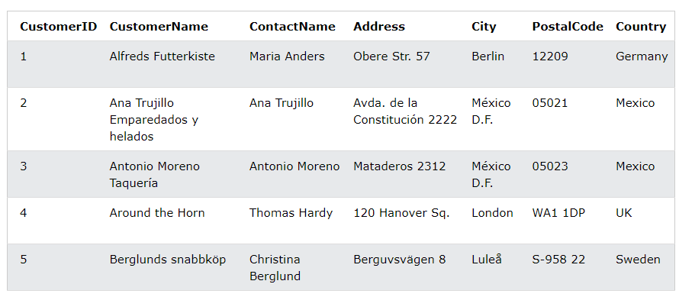
CUSTOMER TABLE
Every table is broken up into smaller entities called fields.
A field is a column in a table that is designed to maintain specific information about every record in the table.
A record, also called a row, is each individual entry that exists in a table.

Slide 4
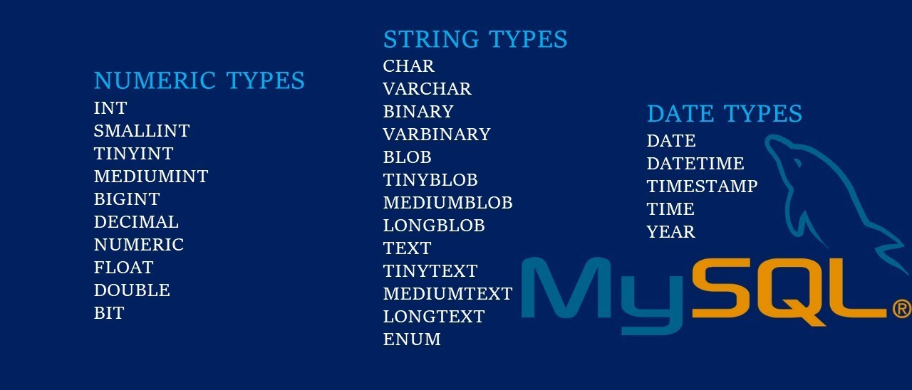
DATATYPES IN SQL

Slide 5
INSTALLATION
sudo apt update
sudo apt install mysql-server (First install server)
sudo mysql_secure_installation
sudo apt install mysql-workbench

Slide 6
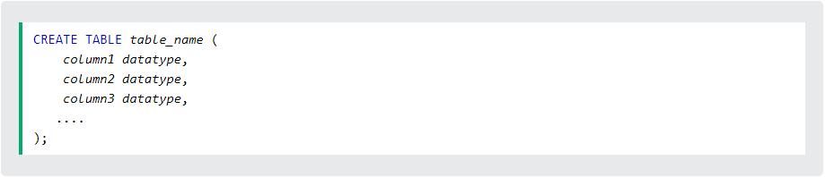
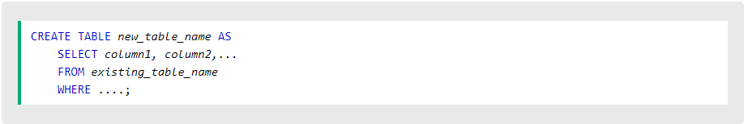
CREATING A TABLE
The CREATE TABLE statement is used to create a new table in a database.
Syntax:
Create table using another table:

Slide 7
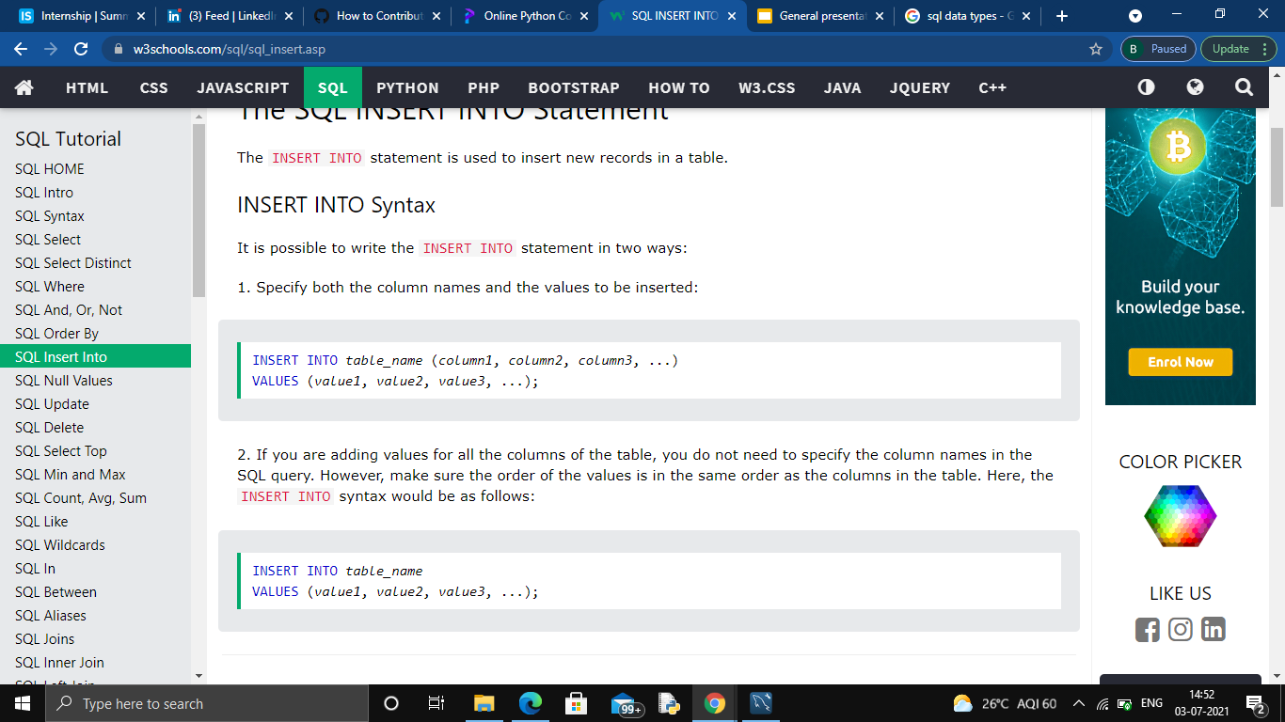
INSERTING VALUES
The INSERT INTO statement is used to insert new records in a table.
Syntax:

Slide 8
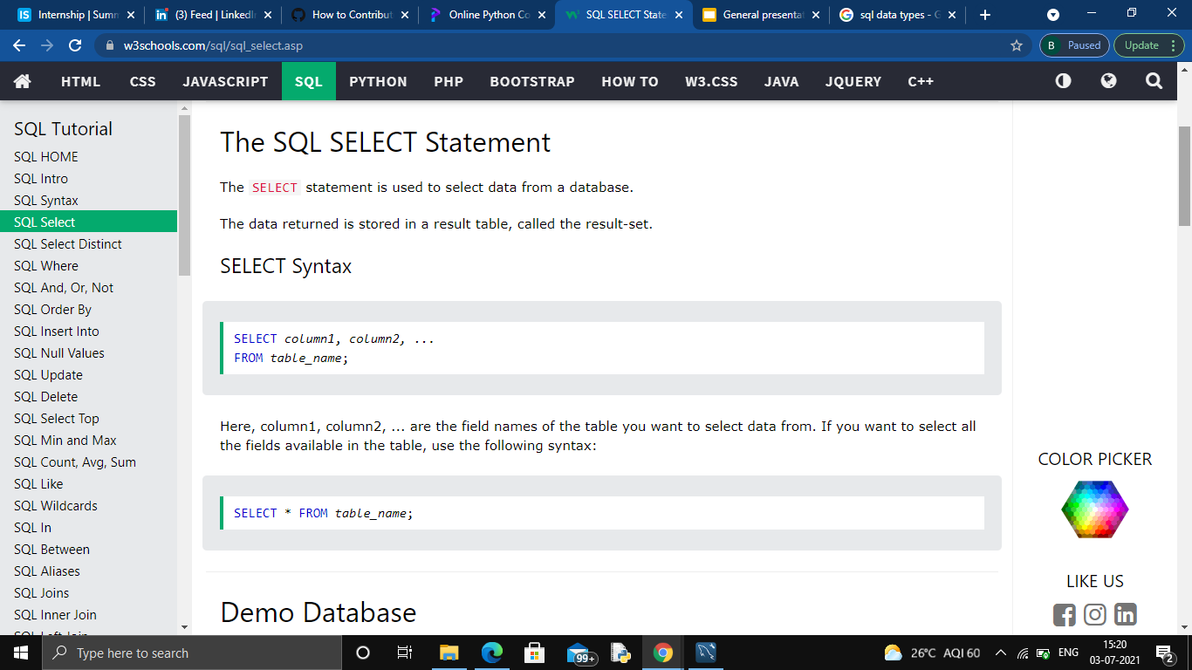
SELECT STATEMENT
The SELECT statement is used to select data from a database.
The data returned is stored in a result table, called the result-set.
Syntax:

Slide 9
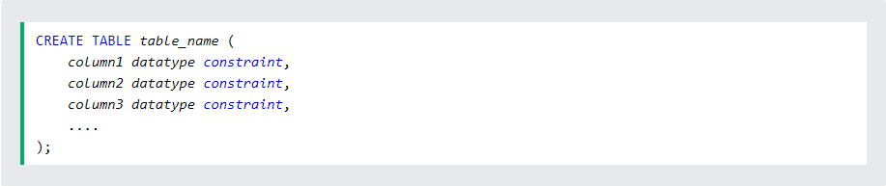
SQL CONSTRAINTS
Constraints can be specified when the table is created with the CREATE TABLE statement, or after the table is created with the ALTER TABLE statement.
Syntax:
SQL constraints are used to specify rules for the data in a table.

Slide 10
The following constraints are commonly used in SQL:
NOT NULL - Ensures that a column cannot have a NULL value
UNIQUE - Ensures that all values in a column are different
PRIMARY KEY - A combination of a NOT NULL and UNIQUE. Uniquely identifies each row in a table
FOREIGN KEY - Prevents actions that would destroy links between tables
CHECK - Ensures that the values in a column satisfies a specific condition
DEFAULT - Sets a default value for a column if no value is specified
CREATE INDEX - Used to create and retrieve data from the database very quickly

Slide 11
SQL JOIN
Here are the different types of the JOINs in SQL:
(INNER) JOIN: Returns records that have matching values in both tables
LEFT (OUTER) JOIN: Returns all records from the left table, and the matched records from the right table
RIGHT (OUTER) JOIN: Returns all records from the right table, and the matched records from the left table
FULL (OUTER) JOIN: Returns all records when there is a match in either left or right table

Slide 12
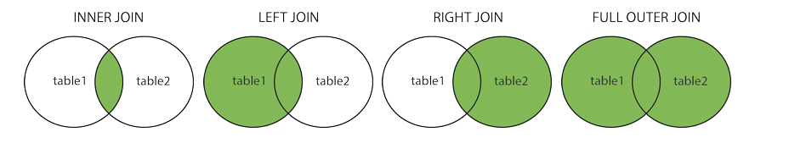
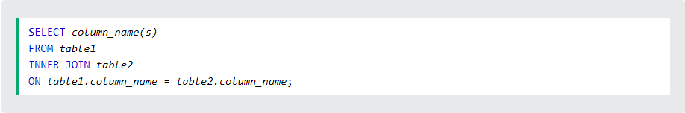
Syntax:

